Slide 1
Reminders
May 7: Poster Day
Scribe

Slide 2
Dimitris Papailiopoulos
University of Wisconsin-Madison
Mitigating Stragglers during Distributed Computation

Slide 3
Algorithm of choice: minibatch SGD
Stores the model
Gradient Computations

Slide 4
Straggler Nodes

Slide 5
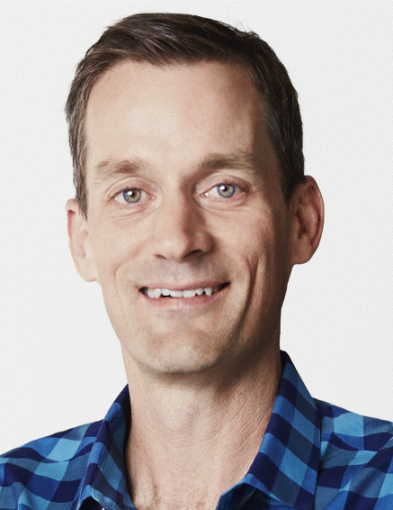
“The scale and complexity of modern Web services make it infeasible to eliminate all latency variability.”
Jeff Dean, Google.
Notes:
Large-scale computing systems have 3 main layers: Storage layer, Communication Layer, and Computation Layer. Data is read from the storage layer, and transmitted through the network towards the computing nodes. The new results of computation are then stored again to complete the loop. each of these steps incurs some delay and uncertainty. Can codes robustify algorithms against this system noise?

Slide 6



Straggling Learners
model
model
model
model
model
How to deal with stragglers?
Measured on Amazon AWS

Slide 7
Stragglers
Ideal compute time per node ~ O(total_time/P)
But there is a lot of randomness:
Network/Comm Delays
Node/HW Failures
Resource Sharing
What if time per node is a random variable:
X = constant + Exp(λ)
Lemma:
Remark:
Slowest node is
log(n) times slower
than fastest

Slide 8
Simulation
X(t) = 1+ Exp(0.5), n = 10, 100, 1000, 1000
Straggler issue:
leads to slower mini-batch SGD implementations

Slide 9
A case against Synchronization
overheads
timeline
CPU 1
CPU 2
CPU 3
stragglers
Asynchronous World
CPU 1
CPU 2
Faster
CPU 3
Easier to Implement

Slide 10
A case against Asynchrony
Can we overcome stragglers
in the synchronous setting?
Asynchronous World
CPU 1
CPU 2
CPU 3
Serial Equialence is missing
Reduces reproducibility of models
Makes theory more complicated

Slide 11
Idea 1: Terminate Stragglers?
model
model
model
model
Q: How many nodes to wait for before moving on to next iteration?
Q: How much does the error affect us?

Slide 12
Expected Savings: Straggler Termination
Let the runtime of each node:
X = 1+ Y, where Y ~ Exp(λ)
Then,
Lemma:
The expected runtime of one node is

Slide 13
Expected Savings: Straggler Termination
If runtime of node is X = 1+ Y, where Y ~ Exp(λ)
Then, let’s define as the k-th fastest runtime
Proof:
Lemma:
The expected runtime of the k fastest nodes

Slide 14
Lemma:
The expected runtime of the k fastest nodes
Proof:
We know that
Then,

Slide 15
Lemma:
The expected runtime of the k fastest nodes
Proof:
We know that
Then,

Slide 16
Lemma:
The expected runtime of the k fastest nodes
Proof:
We know that
Then,

Slide 17
Lemma:
The expected runtime of the k fastest nodes
Proof:
We know that
Then,

Slide 18
Lemma:
The expected runtime of the k fastest nodes
Proof:
We know that
Then,

Slide 19
Lemma:
The expected runtime of the k fastest nodes
Proof:
We know that
Then,

Slide 20
Expected Savings: Straggler Termination
If we wait for the fastest k, then the runtime is
If we wait for all the runtime is
Speedup factor X faster
Q: How much faster did
distributed SGD become?

Slide 21
Expected Savings: Straggler Termination
Say we wait for k = (1-ε)n of all nodes
Each iteration becomes X faster
But we have to perform ~ more iterations
Q: Can we do better?

Slide 22

Replication and backup workers
What if we used some redundancy??
Remarks:
No loss in accuracy
Seems wasteful

Slide 23
Expected Savings: Replication
For every gradient i, the time that the PS will receive it is a random variable
Lemma:
Lemma:
The expected runtime of r-replication

Slide 24
Comparison of expected times
Waiting for all nodes
Waiting for the (1-ε)n fastest
Replicating r-times
Either lose information
Or compute too much
Can we do better?

Slide 25
ERASURE CODES

Slide 26
Coding Theory 101
Replication vs. Codes
Let’s apply this to Stragglers
A
A
B
Can recover A and B from any 1 erasure
B
Can also recover A, B from any 1 erasure
A
A+B
B
How much redundancy for r erasurs?
Replication: factor of r
Codes: factor of 1+r/n

Slide 27

Codes + Matrix Multiply
Task: multiply A and X
Distributed setup: 3 workers, 1 master
A₁X
M
A₂X
A₁
A₃X
A
A₂
W₁
W₂
W₃
A₃
A₁
X
A₂
X
A₃
X

Slide 28


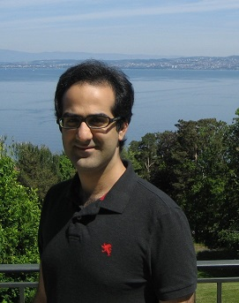

A’₁X
M
A₁
A’₁
A’₂X
A
A₂
A
W₁
W₂
W₃
A’₂
A₃
A’₁
X
A’₂
X
_{(A’1+A’2)}
X
+
Joint with
Kangwook Lee
KAIST
Maximilian Lam
Stanford
Ramtin Pedarsani
UCSB
Kannan Ramchandran
UC Berkeley

Slide 29


MDS-coded Matrix Multiplication
M
A₁X
M
A₁X
A₁
A₂X
AX
A₁
AX
A₃X
A₂X
A
A₂
A
W₁
W₂
W₃
A₂
W₁
W₂
W₃
A₃
A₁
X
A₂
X
A₃
X
A₁
X
A₂
X
A₁+A₂
X
W₁
W₁
W₂
W₂
W₃
W₃
Gain:
time(uncoded) = slowest node
time(MDS coded) = 2nd slowest node

Slide 30
MDS-coded Matrix Multiplication
M
A₁X
M
A₁X
A₁
A₂X
AX
A₁
AX
A₃X
A₂X
A
A₂
A
W₁
W₂
W₃
A₂
W₁
W₂
W₃
A₃
A₁
X
A₂
X
A₃
X
A₁
X
A₂
X
A₁+A₂
X
W₁
W₁
W₂
W₂
W₃
W₃
Gain:
time(uncoded) = slowest node
time(MDS coded) = 2nd slowest node

Slide 31
Comparison of expected times
Waiting for all nodes
Waiting for the (1-ε)n fastest [incurs loss]
Replicating r-times
((1+ε)n, n)-MDS code [no loss]

Slide 32
What can this be applied to?
Linear Regression
Fixed point type algorithms (SVD, Page-rank, etc)
Anything that only involves linear computations ☺

Slide 33
Experimental Results w/ 24 EC2 instances
E[T]
(ms)
500
4-rep
400
3-rep
uncoded (1-rep)
300
2-rep
> 30% speed up
(24,23)
(24,22)
(24,20)
k
200
6 8 10 12 14 16 18 20 22 24

Slide 34
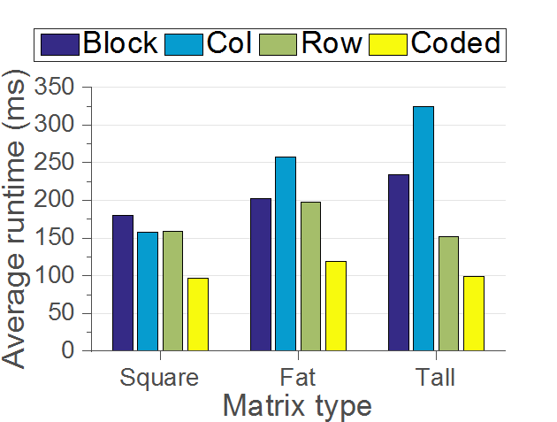
Experiment Results
Experiments with Open MPI on Amazon EC2 cluster of 25 workers
One-shot matrix multiplication ~ 10^8 entries
A 2-parity Erasure Code (Robust to 2 stragglers)
Uncoded
40% speed up
Notes:
40% compared to best of uncoded
paranthesis uncoded the first 3

Slide 35
Beyond Linear?
wants f₁+f₂+f₃+f₄
f₁
f₂
f₃
f₄
f₁+f₂+f₃+f₄
Infeasible as parity = computing the sum

Slide 36
Gradient Coding
Replicating gradients [Tandon et al.]
You can only protect against 1 straggler
No more communication
But compute nodes do 2x work

Slide 37
Open Problems
Beyond linear?
Neural nets with ReLus are “almost” linear
A hybrid between async + codes
Cyclades + codes?
Multicore setups VS distributed

Slide 38
Codes
+
Communication

Slide 39
Parallel Stochastic Gradient Descent (PSGD)
Data
Model
Random
SGD
SGD
SGD
Merge models

Slide 40
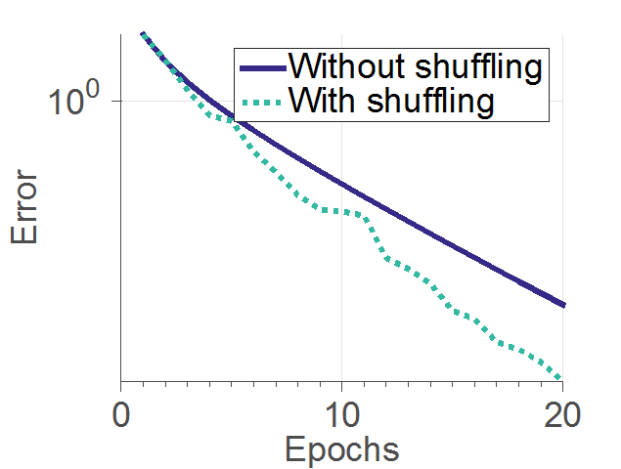
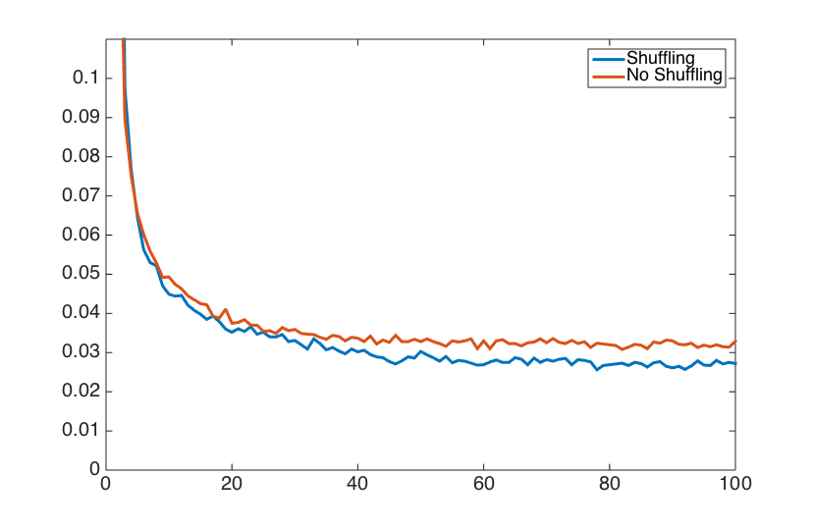
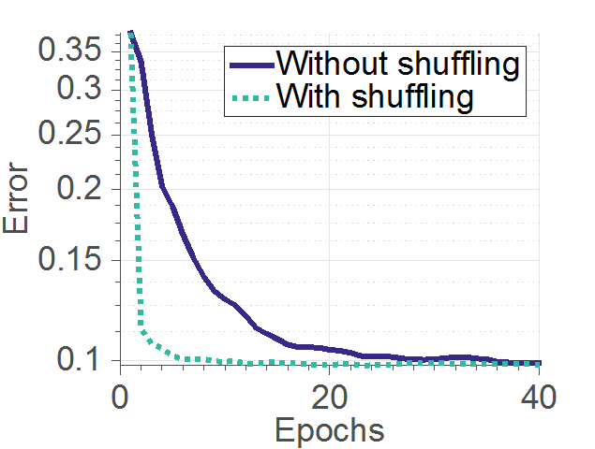
Parallel Stochastic Gradient Descent (PSGD)
Data shuffling
Data
Model
Random
SGD
SGD
SGD
PSGD with shuffling converges faster
Merge models
* [Recht and Re, 2013], [Bottou, 2012], [Zhang and Re, 2014], [Gurbuzbalaban et al., 2015], [Ioffe and Szegedy, 2015], [Zhang et al. 2015]

Slide 41
Uncoded shuffling algorithm
1
2
2
3
3
A
2
3
4
M
2 unicasts
W₁
W₂
1
2
3
4
 | A1, A2 | A3, A4
 | A1, A3 | A2, A4
Pass 1
Pass 2

Slide 42
Data Shuffling
1
2
2
3
3
A
2
3
4
M
Idea:
Exploit redundant information
2 unicasts
W₁
W₂
1
2
3
4
 | A1, A2 | A3, A4
 | A1, A3 | A2, A4
Pass 1
Pass 2

Slide 43
Coded Shuffling
1
2
2
3
A
3
4
1
2
2
3
A
3
4
M
M
2 unicasts
W₁
W₂
W₁
W₂
1
3
2
4
1
2
2
3
3
4
 | A1, A2 | A3, A4
 | A1, A3 | A2, A4
Pass 1
Pass 2

Slide 44
Coded Shuffling
1
2
2
3
A
3
4
1
2
2
3
A
3
4
2+3
2+3
M
M
2 unicasts
1 broadcast
W₁
W₂
W₁
W₂
1
3
2
4
1
3
2
2
3
4
 | A1, A2 | A3, A4
 | A1, A3 | A2, A4
Pass 1
Pass 2

Slide 45
Theorem:
n = # data points
P = # workers
β = excess memory per worker ( = how much a worker can store / (n/P) )
Learning setup: each pass, the master randomly permutes data
Then, communication costs (in expectation):

Slide 46
10
9
Uncoded
n = 10^7
p = 20
8
7
6
# of transmissions / 10^6
5
Simulation
4
3
Theory
2
1
2
4
6
8
10
12
14
16
18
20
Memory overhead

Slide 47
Regression on amazon EC2, 20 workers
35% speed up

Slide 48
Next time
From Training to Inference
Computational Considerations
Low-precission
Adversarial examples, attacks and defenses

Slide 49

The goal:
Enable Scalable
Distributed Learning
Optimal Compression?
Optimal Comm. Scheme?
Optimal Straggler Mitigation?
Async vs Sync
What is the “optimal” platform?

Slide 50
The end

